Slide 1
Comparative Study Of Image Segmentation Algorithms

Slide 2
What is Image Segmentation
Image segmentation refers to the technique to segregating sets of pixels in an digital image.
The result of image segmentation is a set of segments that collectively cover the entire image, or a set of contours extracted from the image. Each of the pixels in a region are similar with respect to some characteristic or computed property, such as colour, intensity or texture.
Applications:- Medical Imaging, Machine vision, Recognition, Video Surveillance

Slide 3
Premise
In my study, various image segmentation techniques were used for object detection in field of phenomics.
An image dataset consisting of top view and side view of plants was processed to detect the foreground i.e. plant body in the digital image.
Comparative study was done on the results obtained from these different techniques.

Slide 4
Algorithms used for edge detection
Active Contour segmentation
Otsu segmentation
Graph cut/Grab cut segmentation
K-means clustering
Watershed segmentation

Slide 5
Active Contour segmentation
Proposed by Kaihua Zhang et.al.
This technique uses region based signed pressure force (SPF) which stops the contours at weak or blurred images.
The exterior and interior can be automatically detected with the initial contour being anywhere.
It uses a new level set function re-initialization method Selective Binary and Gaussian Filtering Regularized Level Set (SBGFRLS).
The level set functions is binary initialized.
It uses Gaussian filter to minimize the ‘noise’. Smoothen the image.

Slide 6
The function is defined as
where spf is the signed pressure function.
Φ-levelset function

Slide 7
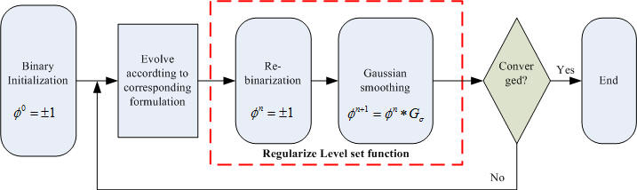
Algorithm Flowchart

Slide 8
Advantage
Complex image data can be used if prior knowledge is trained into the software.
Disadvantages
The technique is not fully automated, it requires user interaction.
It requires prior knowledge to successfully detect contour in image.

Slide 9
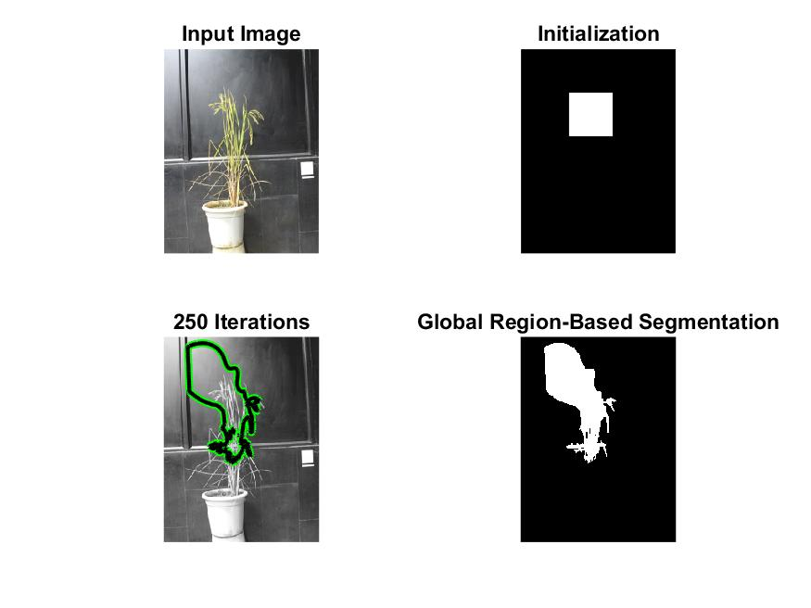
Results

Slide 10
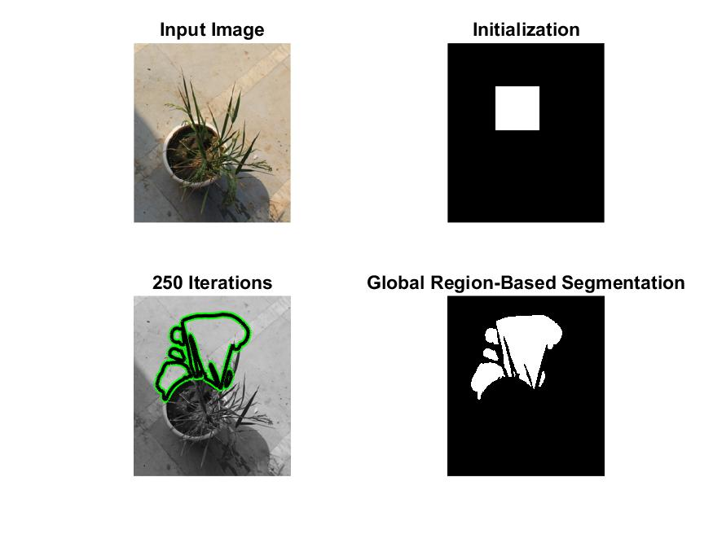

Slide 11
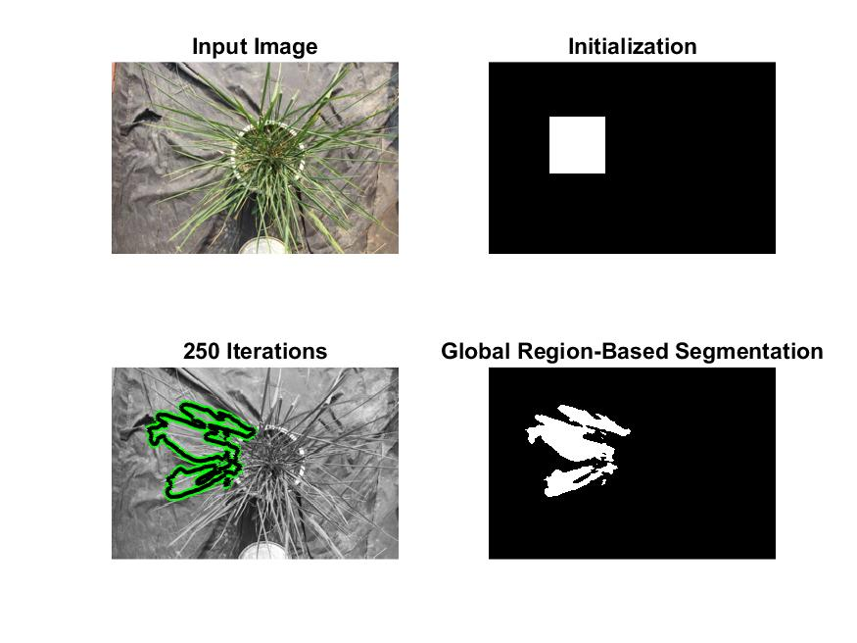

Slide 12
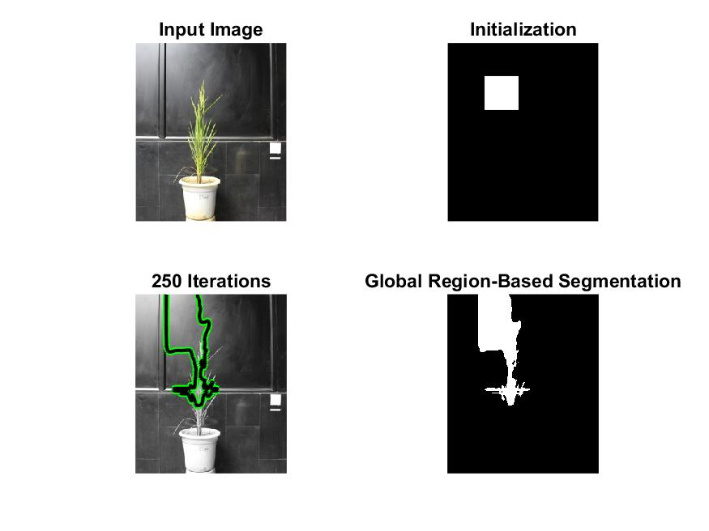

Slide 13
Otsu’s Method
Proposed by Nobuyiki Otsu.
It is used to perform clustering based image thresholding.
A graylevel image is reduced to binary image consisting of foreground and background.
It assumes image contains two classes of pixels (foreground and background pixels).
Optimal threshold is calculated which separates the two classes.
Image thresholding: It is a technique assigning labels to pixels in digital image on basis of threshold value. For example implementing two classes of pixels, some pixel’s labels can be assigned value 1 and others value 0 on basis of threshold value.

Slide 14
Advantage
It gives best results if the histogram possess a deep and sharp valley between two peaks. (bimodal distribution).
Disadvantage
The technique does not perform well if image contains small object, small mean distance, large variance of object large amount of noise etc.

Slide 15
Graph Cut Segmentation
It is used to solve low-level computer vision problems that can be formulated in terms of energy minimization.
The energy minimization problems can be solved using max flow min cut algorithm.
It outputs a binary image consisting of foreground pixels having value 1 and background pixels having value 0.
Iterated graph cut(Full automation) , Dynamic graph(semi automation) cut can be used accordingly.
A variant, Grab cut segmentation is better implementation of graph-cut segmentation as it iterates over each step and allows user to improve upon the results . The user can manually correct the detected edge to improve the accuracy of final segmented image.

Slide 16
Advantage
It is useful for energy minimization in low level vision problems.
Disadvantages
Shrinking bias: Since graph cuts finds a minimum cut, the algorithm can be biased toward producing a small contour. For example, the algorithm is not well-suited for segmentation of thin objects like blood vessels.
Memory: the memory usage of graph cuts increase quickly as the image size increase

Slide 17
K means clustering
The algorithm is used to k clusters of pixels which can then be reshaped to image.
N observations are made into k clusters in which each observation belongs to the cluster with the nearest mean.
Each observation is assigned to the cluster whose mean yields the least within-cluster sum of squares (WCSS)
It uses Euclidean distance for cluster center initialization, So it has total k centers i.e. for each cluster.

Slide 18
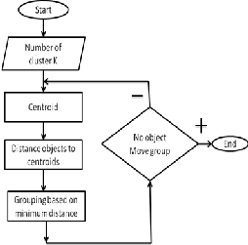
Algorithm flowchart

Slide 19
Advantages : 1) If variables are huge, then K-Means most of the times computationally faster than hierarchical clustering, if we keep k smalls. 2) K-Means produce tighter clusters than hierarchical clustering, especially if the clusters are globular. Disadvantages : 1) Difficult to predict K-Value. 2) With global cluster, it didn't work well. 3) Different initial partitions can result in different final clusters. 4) It does not work well with clusters (in the original data) of Different size and Different density

Slide 20
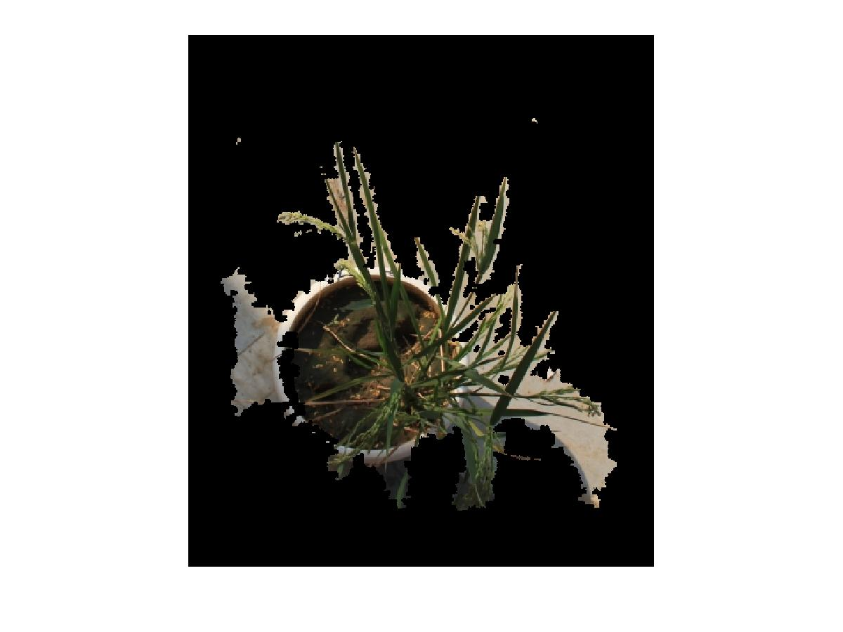
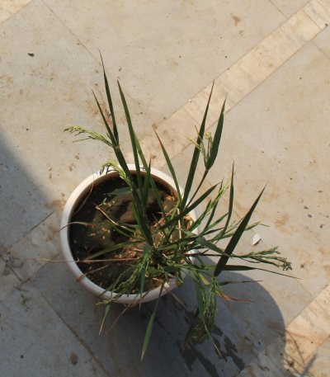
Combined results from k-means clustering and Grab-cut algorithm implemented in SegTool
Input Image
Output Image

Slide 21
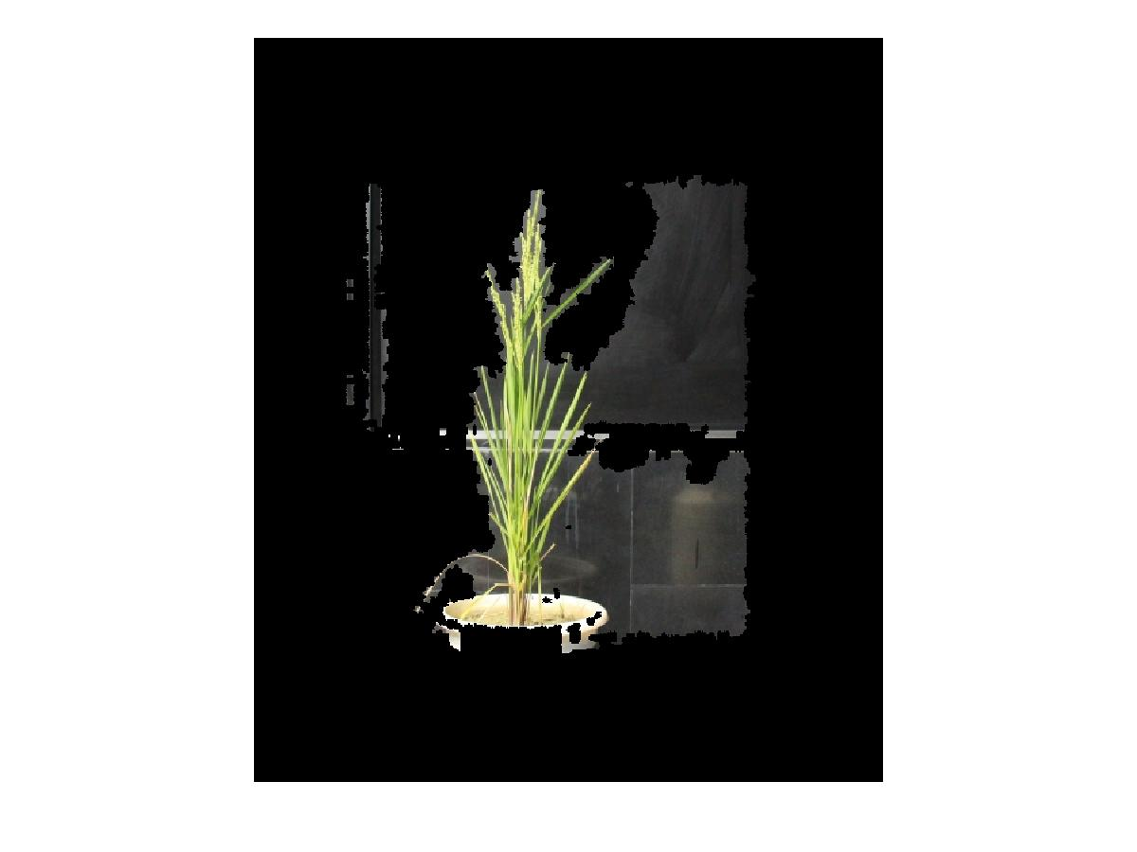
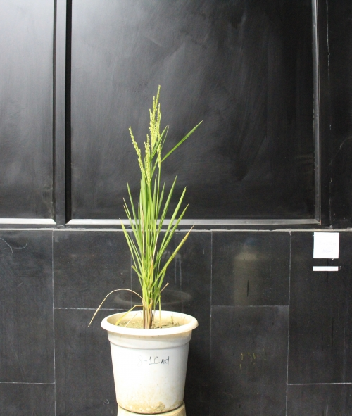
Input Image
Output Image

Slide 22
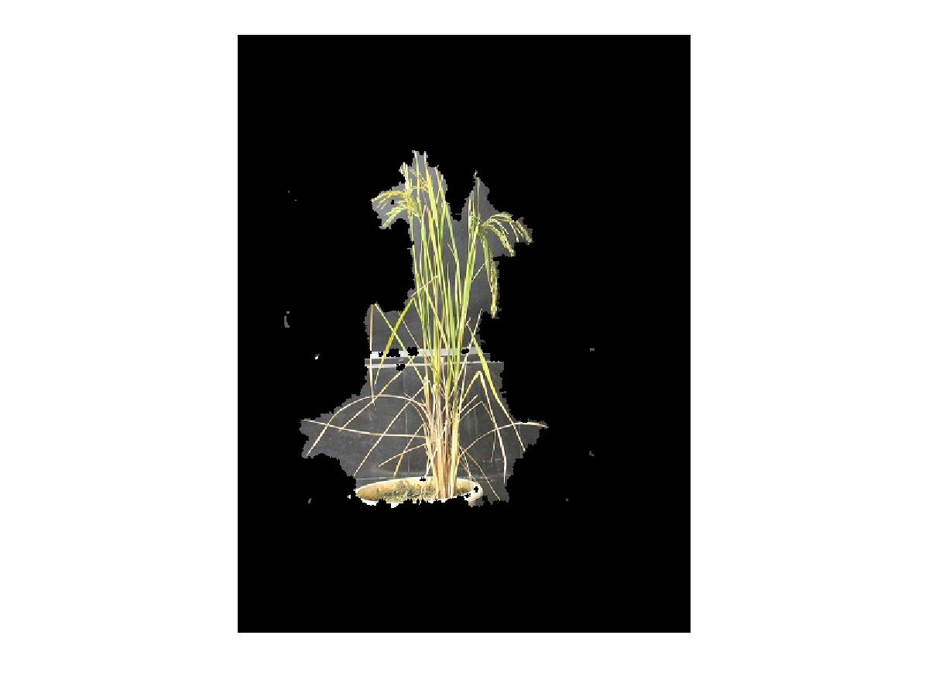
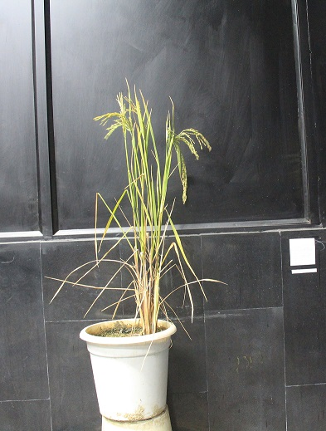
Input Image
Output Image

Slide 23
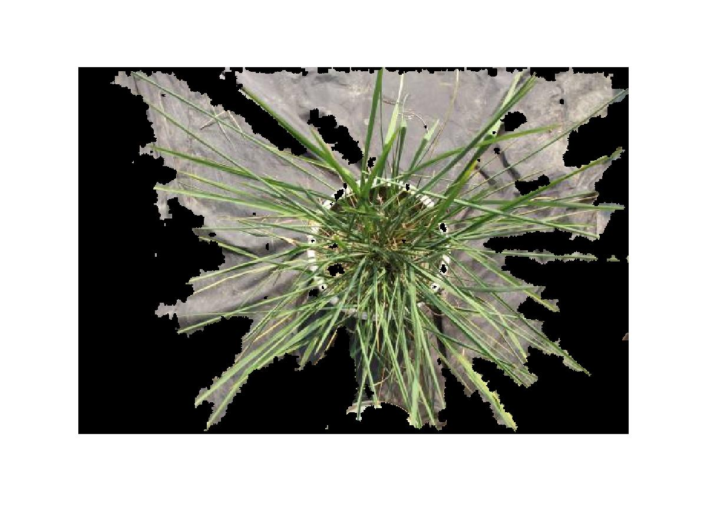
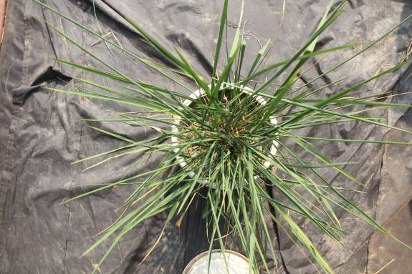
Input Image
Output Image

Slide 24
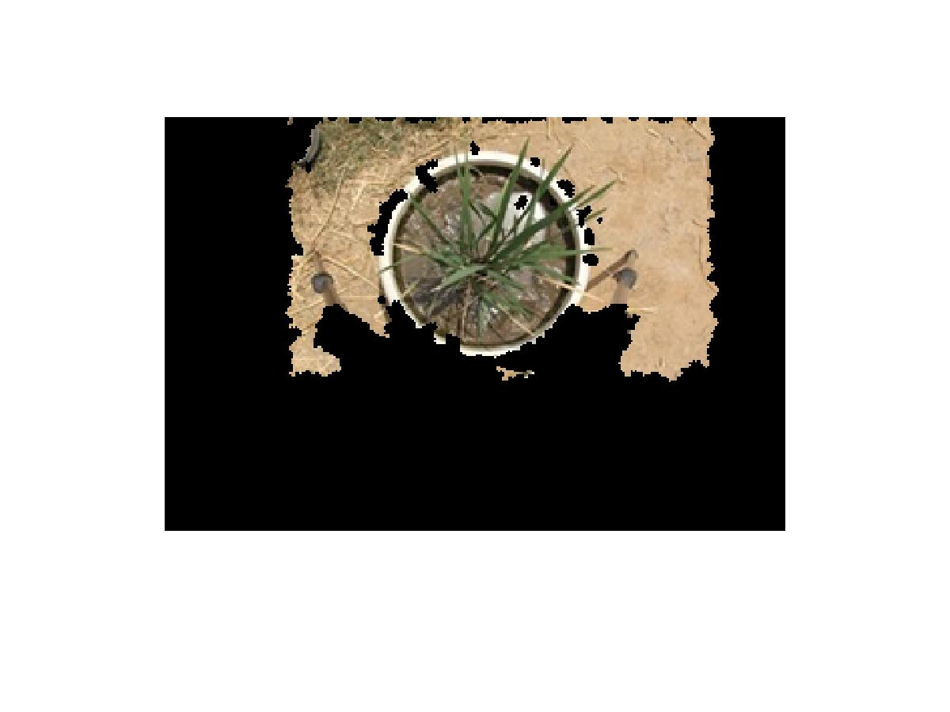
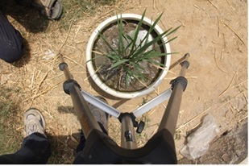
Input Image
Output Image

Slide 25
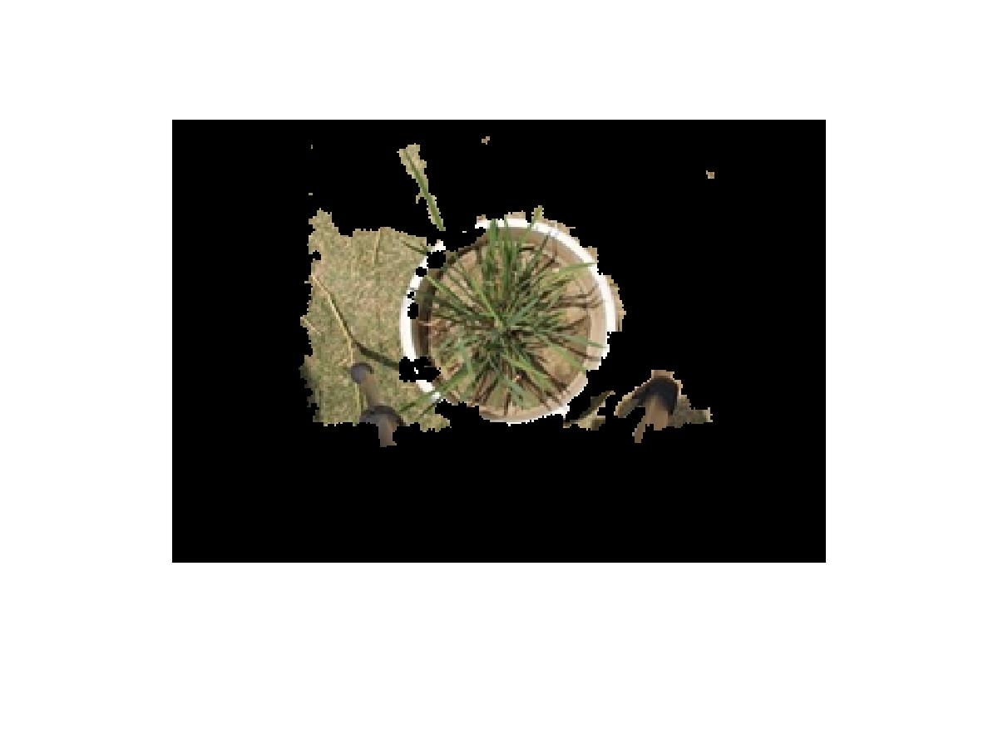
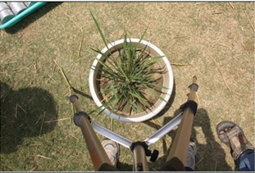
Input Image
Output Image

Slide 26
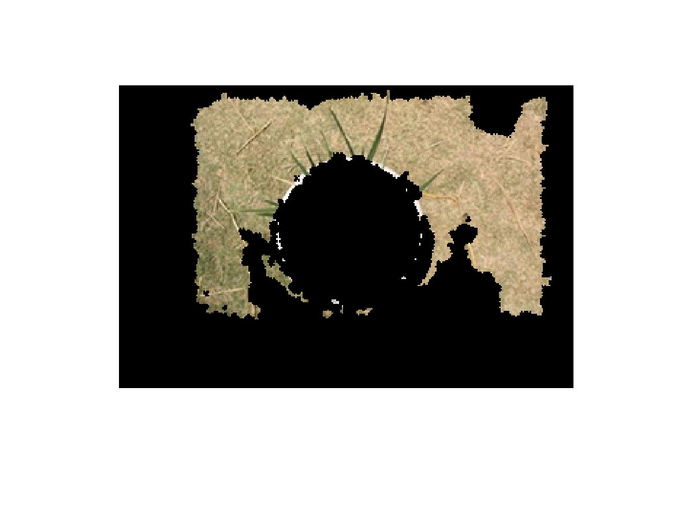
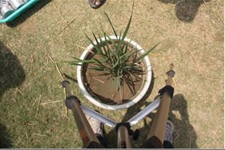
Input Image
Output Image

Slide 27
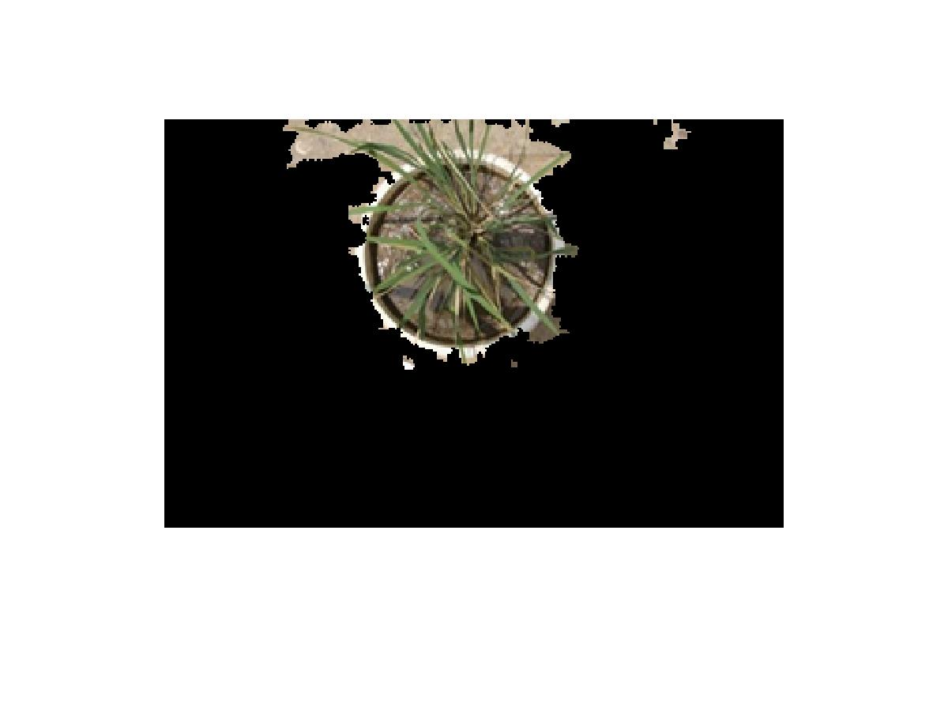
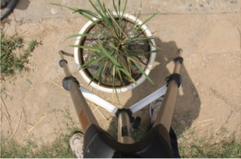
Input Image
Output Image

Slide 28
Watershed Segmentation
The Algorithm is as follows:
A set of markers, pixels where the flooding shall start, are chosen. Each is given a different label.
The neighboring pixels of each marked area are inserted into a priority queue with a priority level corresponding to the gradient magnitude of the pixel.
The pixel with the lowest priority level is extracted from the priority queue. If the neighbors of the extracted pixel that have already been labeled all have the same label, then the pixel is labeled with their label. All non-marked neighbors that are not yet in the priority queue are put into the priority queue.
Redo above until the priority queue is empty.
The non-labeled pixels are the watershed lines.

Slide 29
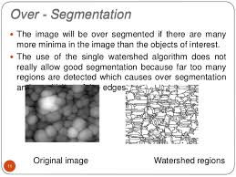
Advantages
The boundaries of the resulting regions always correspond to contours which appear in the image as obvious contours of objects.
The union of all the regions forms the entire image region.
Disadvantage
Main disadvantage of this algorithm is, for most natural images it produces excessive over-segmentation.

Slide 30
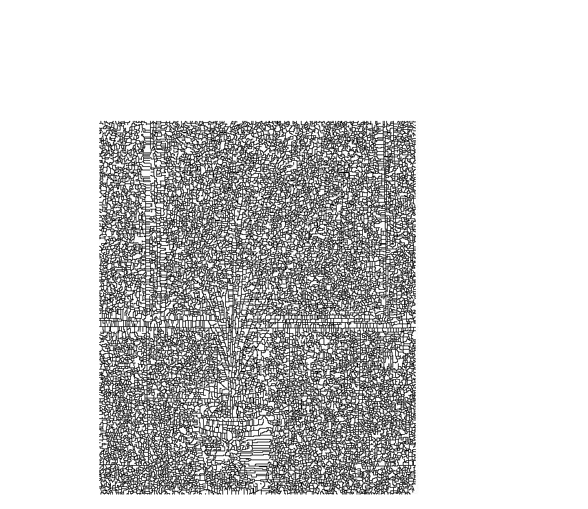
Input Image
Output Image

Slide 31
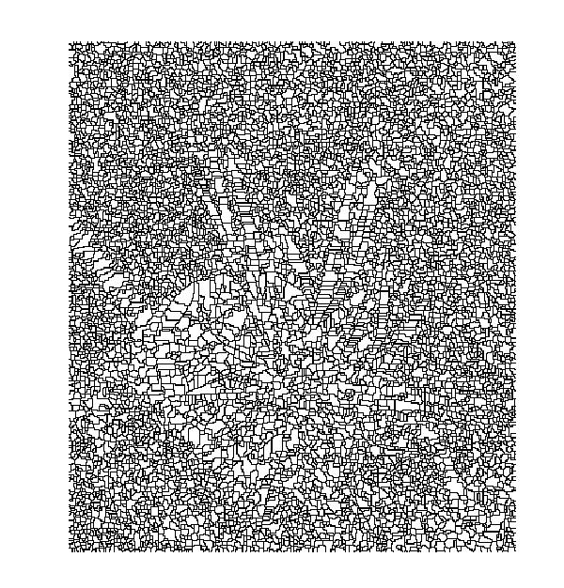
Input Image
Output Image

Slide 32
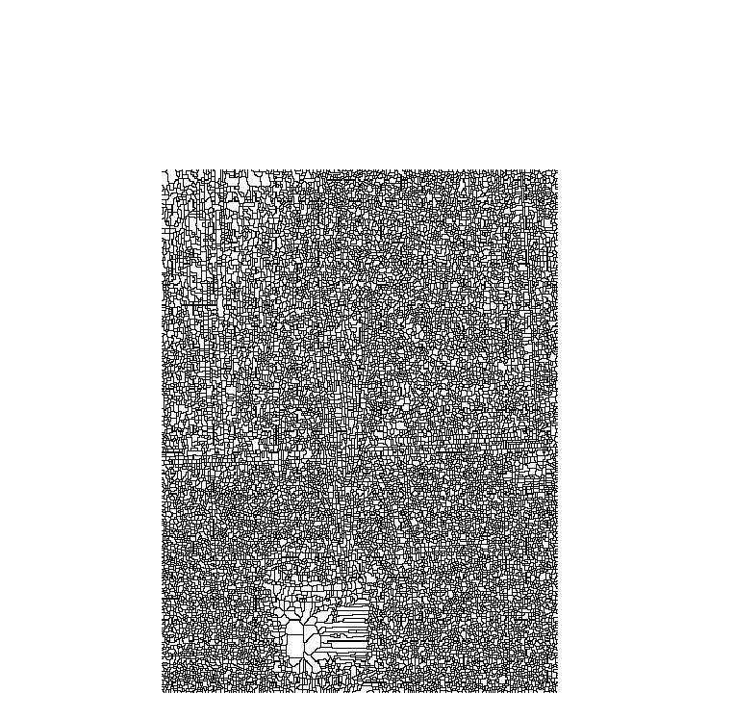
Input Image
Output Image

Slide 33
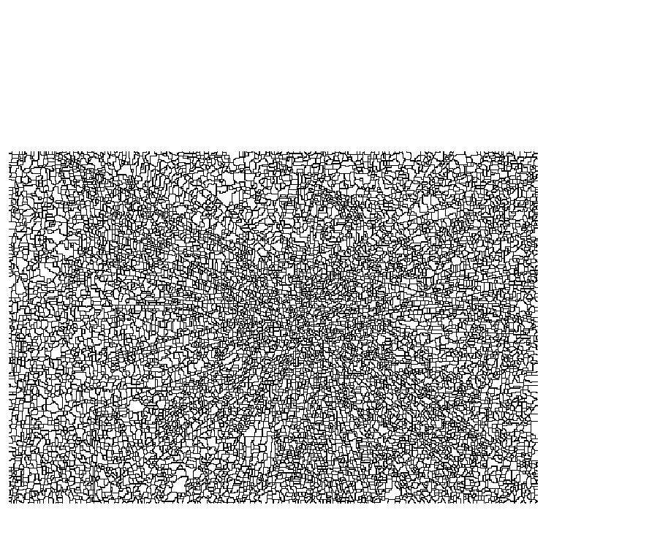
Input Image
Output Image

Slide 34
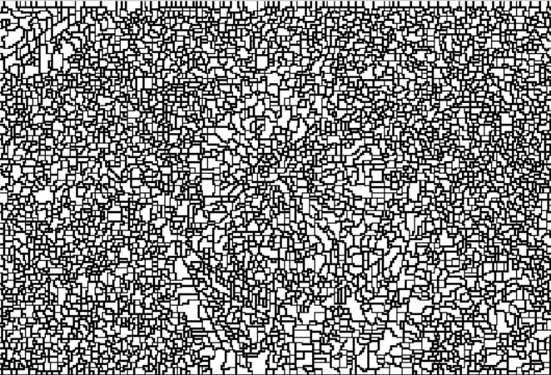
Input Image
Output Image

Slide 35
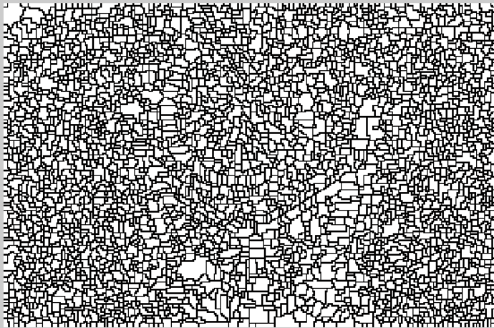
Input Image
Output Image

Slide 36
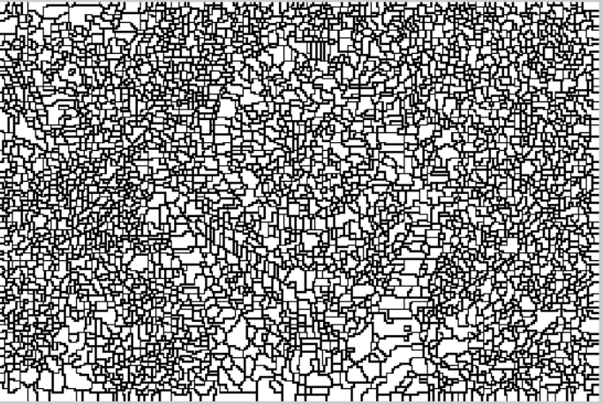
Input Image
Output Image

Slide 37
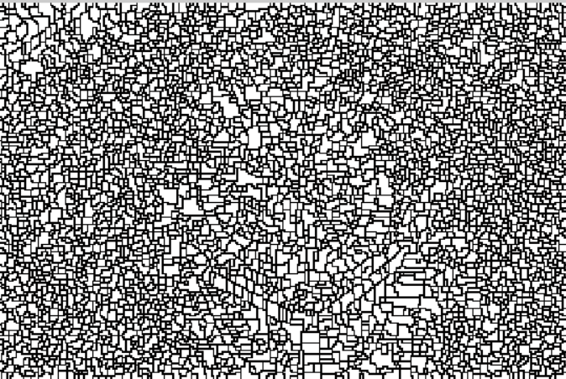
Input Image
Output Image

Slide 38
CASE STUDY Minnervini’s Proposed Segmentation Algorithm

Slide 39
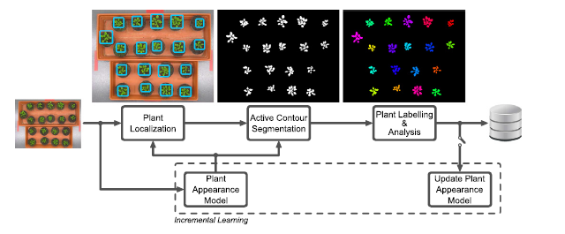
Summary
The Research Paper “Image-based plant phenotyping with incremental learning and active contours” proposes an algorithm which uses active contour segmentation technique to segregate multiple plant objects in a digital image.
The software can be trained with ‘Prior’ knowledge to obtain better results.
It uses machine learning to improve upon its previous results.(Uses previous gmm.mat file if present)

Slide 40
Steps
User initially has to provide number of plants and grouping of mutants (if any) to the application.
After an image is acquired, plant objects are localized thus obtaining approximate plant segregation.
Each region containing a plant is segmented with active contour model to accurately delineate the plant from background.
Each segmented plant is labelled with an identifier in correspondent to previous images, thus it allows analyst to study plants body over span of time.
The processed data and segmentation are added to existing database and are updated accordingly on each iteration.

Slide 41
Some Key Features
Texture information and colour features are extracted from the images to effectively segment the plants from background. Plant appearance model is used to segregate the plant body from background.
To provide scalability, a method of learning is incorporated in this technique.
The techniques allows software to learn colour and texture appearance of plants using a multi-dimensional Gaussian mixture model (GMM).

Slide 42
Image based features
CIE l*a*b colour space is used to gather information regarding intensities of colours, where ‘a’ is colour position between green & red and b is colour position between blue & yellow.
Texture & intensity features are used to distinguish between background and foreground. Co-occurrence matrices or Gabor filters can be used to create multi-scale representation of local texture characteristics.
Texture detection filter is used to as local texture descriptor. The response of a pillbox filter is linearly combined with a Difference of Gaussians (DoG) filter. A pillbox filter is a circular uniform kernel Hρ of radius ρ. The DoG filter operates by subtracting a blurred version of an intensity image from another blurred version of the same image, where the different blurring is usually obtained by convolving with a pair of Gaussian kernels.

Slide 43
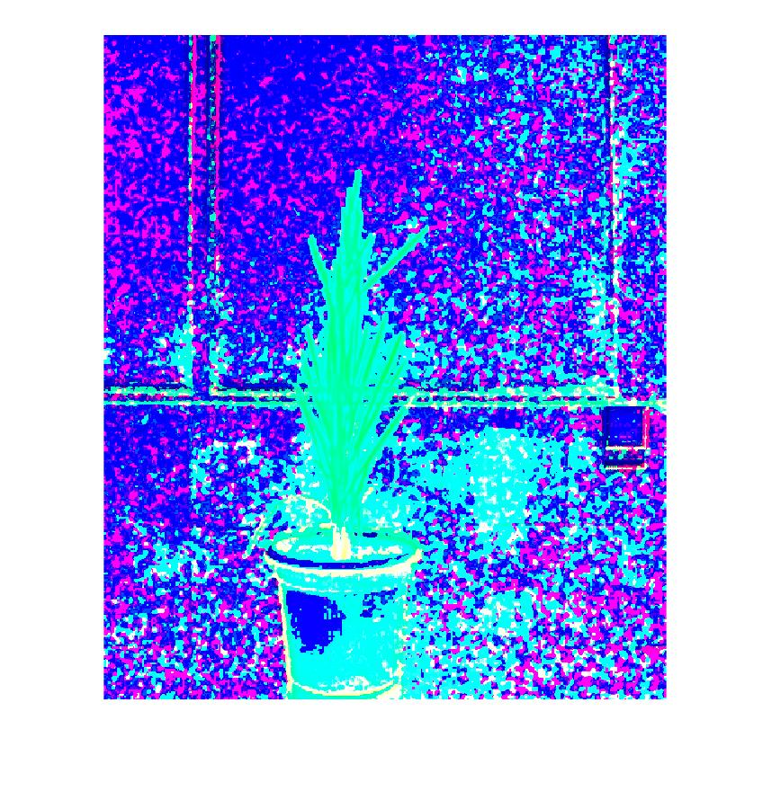
Texture features from dataset
Output Image
Input Image

Slide 44
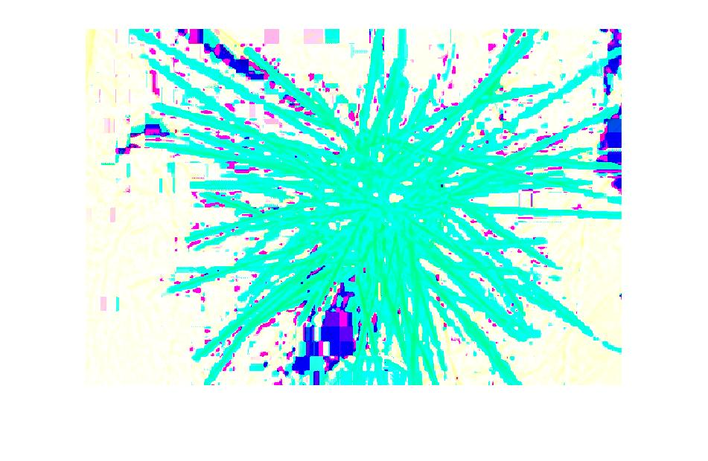
Input Image
Output Image

Slide 45
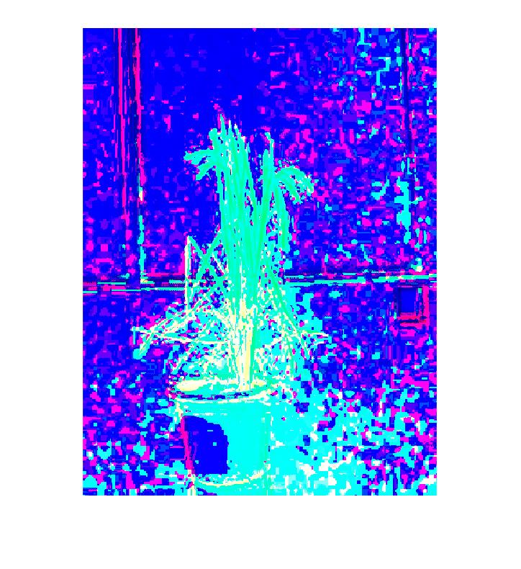
Input Image
Output Image

Slide 46
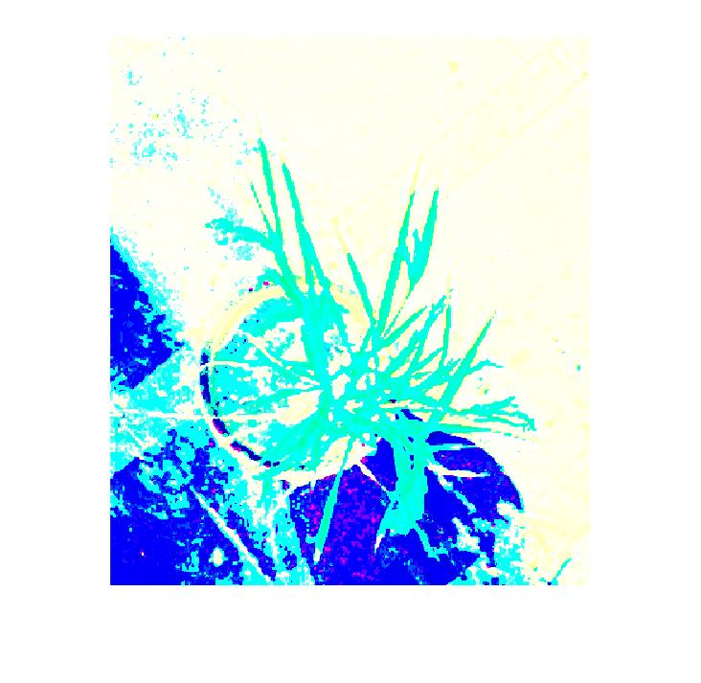
Input Image
Output Image

Slide 47
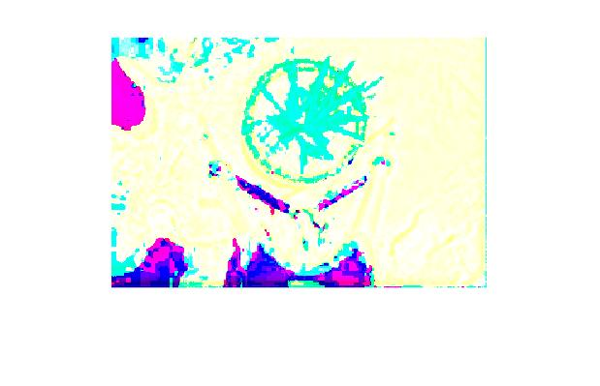
Input Image
Output Image

Slide 48
Input Image
Output Image

Slide 49
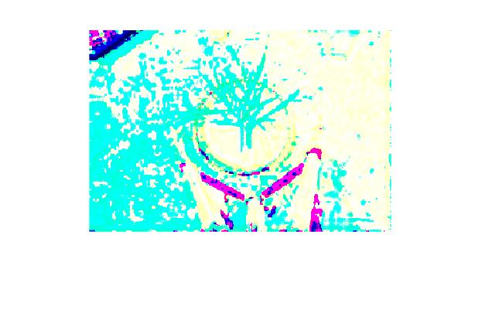
Input Image
Output Image

Slide 50
Input Image
Output Image

Slide 51
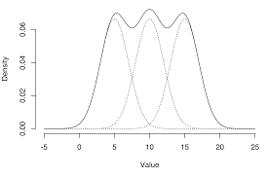
Gaussian Mixture Model
It is a a mixture model that corresponds to the mixture distribution that represents the probability distribution of observations in the overall population.
For example, consider three Gaussian function representing probability of variables/observations. Then the Gaussian mixture model in this case would represent the distribution in the all the observations.

Slide 52
Difference of Gaussians filter
Difference of Gaussians is a feature enhancement algorithm that involves the subtraction of one blurred version of an original image from another, less blurred version of the original. In the simple case of grayscale images, the blurred images are obtained by convolving the original grayscale images with Gaussian kernels having differing standard deviations. Blurring an image using a Gaussian kernel suppresses only high-frequency spatial information.
It helps in highlighting different types of features, for example minute details in an image can be enhanced using small Gaussian kernel.

Slide 53
Plant Localization
For segmenting each plant from an image K-means clustering algorithm is used. It clusters a pixel as plant or background in the original image.
In absence of a plant model or prior knowledge Centroids are calculate from histograms thresholding in the Excess Green colour space. Otsu’s thresholding is used to identify a where R,G&B are components of RGB colour space.
In presence of plant appearance model, the available information is use to get more accurate initial cluster centroid.
The initial cluster centroids are found by averaging foreground and background pixels respectively.
Subsequently, after the algorithms converges to square box, we find each plant object and output this region.
The end result of this process is a collection of rectangular regions of interest, whose union reconstructs the original image.

Slide 54
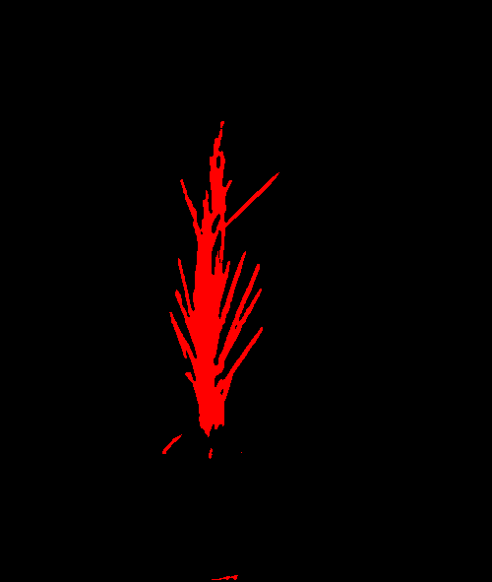
Results from Minnervini’s implementation
Input Image
Output Image

Slide 55

Input Image
Output Image

Slide 56
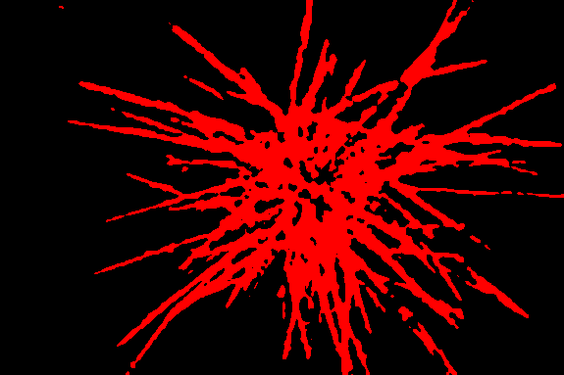
Input Image
Output Image

Slide 57

Input Image
Output Image

Slide 58
Deduction from results
The Minnervini’s implementation gives better results in comparison to other techniques/software currently available.( in case of good quality digital images of plant)
The software is almost fully automated as the user is only required to enter the number of plant objects initially.
The software outputs most accurate results if the digital image has contrasting background and foreground pixels values.
It outputs least accurate results if the plant image has optical reflectivity(For eg floor reflecting sunlight ).

Slide 59
Proposed solution
To improve accuracy by incorporating texture features from Minnervini’s implementation in SegTool software(which uses auto-cut).
SegTool software uses k-means clustering and watershed segmentation which relies on colour feature of the digital image to detect contour of the object.
We can improve the accuracy of the software if we utilized the texture features extracted from image. Label some pixels as initial foreground and background pixels on the obtained texture features. And then perform segmentation using colour features of the image.

Slide 60
*** END ***
By: Apoorv Tomar
B.Tech, IIIrd Year NIT Delhi

